Slide 1


MERN Stack Development
MERN stack development leverages the strengths of MongoDB, Express.js, React, and Node.js to create robust full-stack web applications. This versatile architecture enables developers to build dynamic and high-performance applications, utilizing JavaScript across both client and server sides.

Slide 2

Introduction
Hello, I am Jay Khatik.
📍 Ahmedabad, India | 🎓 B.C.A Student | Aspiring MERN Stack Developer
"I am a dedicated and adaptable individual with a strong desire to learn and grow. I am currently pursuing a Bachelor's degree in Computer Applications and developing my skills in MERN Stack Development at TOPS Technologies. I enjoy creating clean, responsive, and scalable web applications that solve real-world problems."
Highlights :
💻 Skills: React.js, Node.js, Express.js, MongoDB, HTML, CSS, Bootstrap
🧪 Internship: Web + IoT Development at Infolabz , Ahmedabad
🛠 Projects: i) Smarteen Card ii) NiviaSport Clone iii) Zay Shop
🧠 Strengths: Creativity, Time Management, Teamwork
🎯 Interests: Singing, Cricket, Traveling, Music

Slide 3





Contact Information
Name
1
Jay Khatik
E-mail
2
jaykhatik1905@gmail.com
LinkedIn
3
linkedin.com/in/jay-khatik/
Phone
4
+91 9879813898

Slide 4
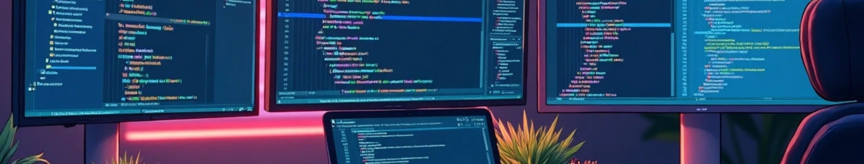
Introduction to the MERN Stack
What is MERN?
Full-Stack Development
JavaScript Everywhere
MERN is a JavaScript stack consisting of MongoDB, Express.js, React, and Node.js, facilitating end-to-end development.
MERN allows developers to work on both front-end and back-end, ensuring seamless integration.
Using JavaScript across all components simplifies development and reduces context switching.

Slide 5
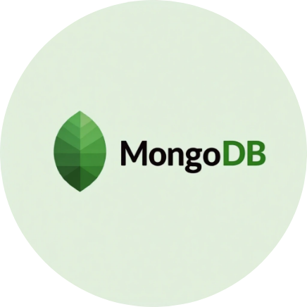
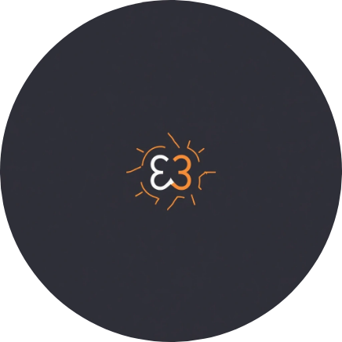

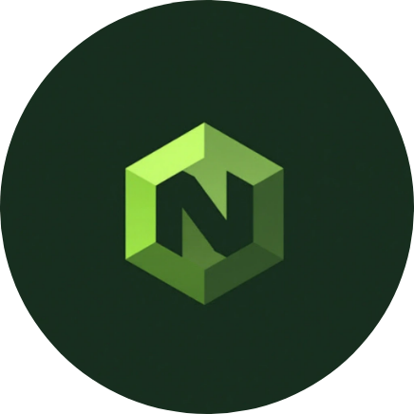
MERN Stack Tools
MongoDB
Express.js
React
Node.js
A NoSQL database that stores data in flexible JSON-like documents.
A web application framework for Node.js, designed for building APIs.
A JavaScript library for building dynamic user interfaces for web apps.
A JavaScript runtime built on Chrome's V8 JavaScript engine for backend development.

Slide 6





MongoDB Overview
Scalability
Designed to handle large volumes of data and can be scaled horizontally.
Document-Oriented
NoSQL Database
Data is stored in collections of documents, allowing for rich queries and indexing capabilities.
MongoDB is a NoSQL database that stores data in flexible, JSON-like documents.
2
1
3

Slide 7


Express.js Essentials
1
Web Framework
A minimal and flexible Node.js web application framework.
2
Middleware Support
Uses middleware for efficient request and response handling.
3
API Development
Widely used for building RESTful APIs.

Slide 8

React.js Fundamentals
1
Component-Based Architecture
2
Virtual DOM
3
State Management
React's Virtual DOM enhances performance by minimizing direct interactions with the real DOM, allowing for efficient updates and rendering.
With state management tools like Redux, React applications can handle complex data flows and improve the organization of the application state.
React.js utilizes a component-based architecture, enabling developers to build reusable UI components, leading to more maintainable code.

Slide 9
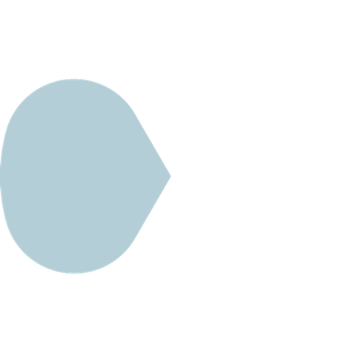


Node.js Functionality
Event-Driven Architecture
2
It’s lightweight and efficient for I/O-intensive applications.
JavaScript Runtime
Node.js enables server-side JavaScript execution.
1
Package Management
3
npm streamlines code sharing and dependency management.

Slide 10


Building a MERN Application
1
2
3
4
Project Setup
Creating the API
React Front-End
Integration and Testing
Set up a new Node.js project and install packages.
Develop back-end API using Express.js for data interaction.
Build front-end components with React interacting with API.
Integrate components and test application functionality.

Slide 11


Conclusion on MERN Stack
Benefits of MERN
Community and Resources
Future Trends
The MERN stack allows for rapid development, code reusability, and a unified language across the stack, making it an attractive choice for developers.
As web applications continue to evolve, the MERN stack is likely to adapt, incorporating new tools and methodologies to stay relevant in the tech landscape.
A vibrant community and extensive resources are available for MERN development, providing support and tools for developers at all levels.

Slide 12
Thank You

